Slide 1

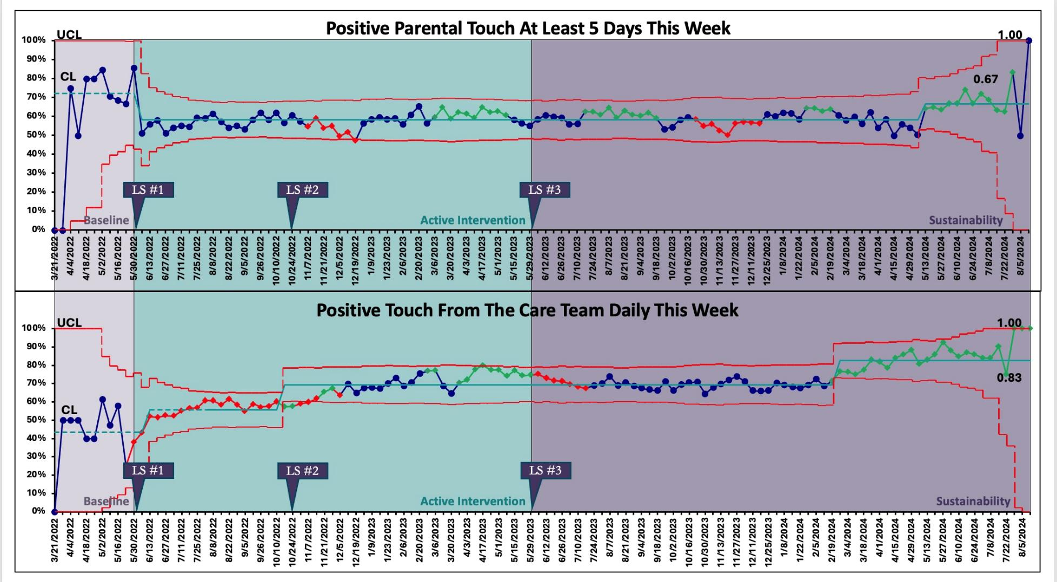
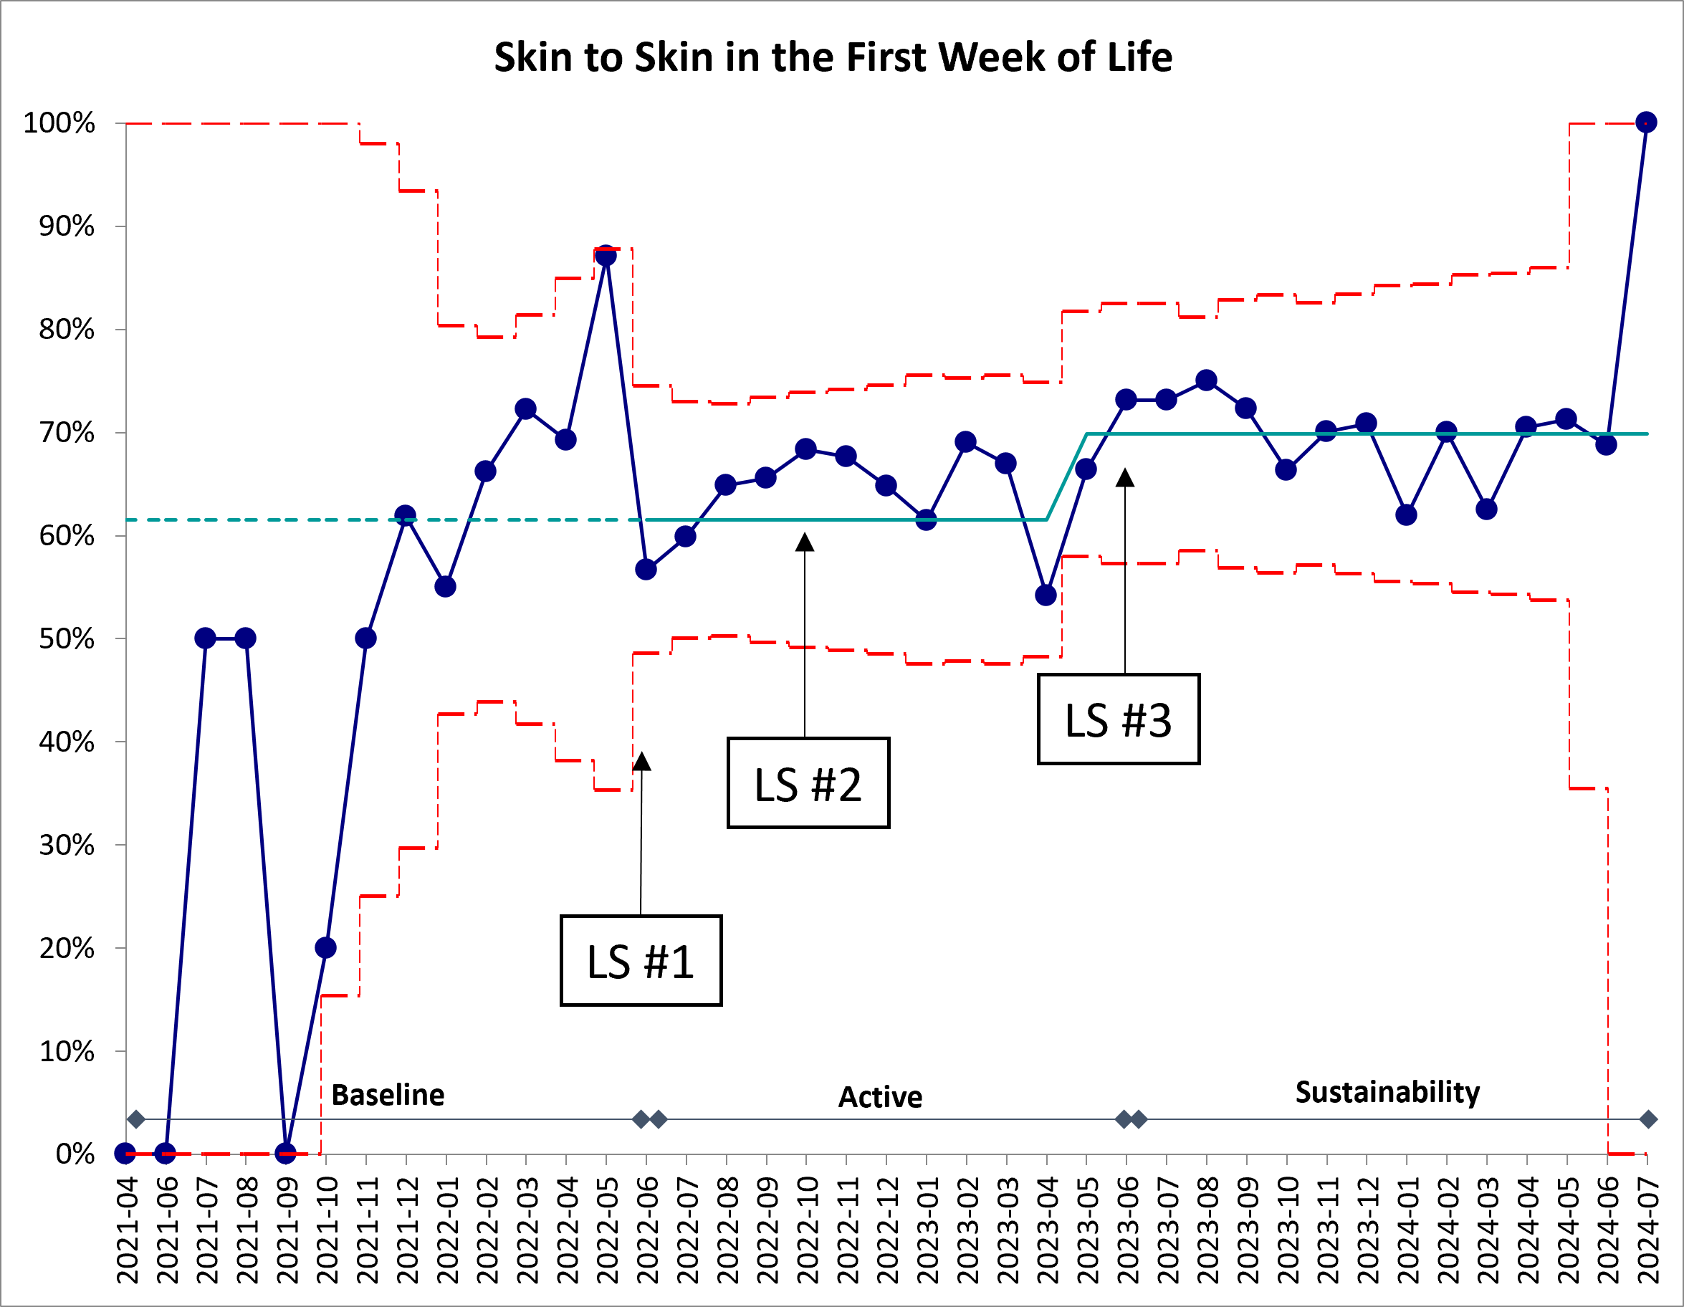
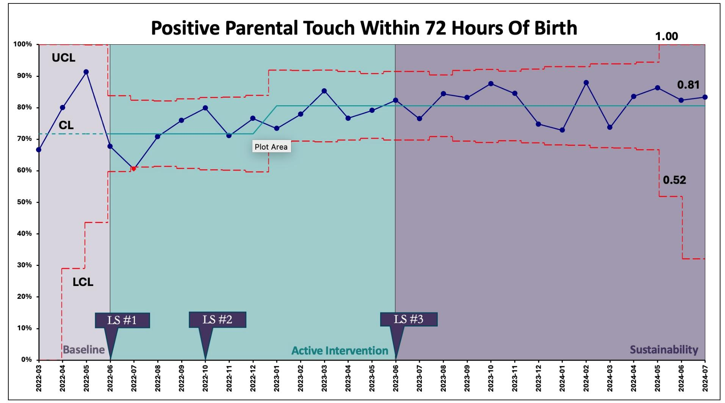
Using statewide QI collaboration to improve neuroprotective care and outcomes for preterm infants and their families
Mindy Morris, DNP, Courtney C. Breault, MS, RN, Xin Cui, MPH, PhD, Jessica Liu, MPH, PhD, Jennifer M. Canvasser, MSW,
Necole McRae, AA, AS, BA, Roberta Pineda, PhD, OTR/L, CNT, Elizabeth E. Rogers, MD, Jochen Profit, MD, MPH
On behalf of the California Perinatal Quality Care Collaborative (CPQCC) NEOBrain collaborating centers
BACKGROUND
FIGURE 1: Positive touch provided by parents and care team.
FIGURE 3: STS provided in first week of life.
Preterm neonatal survival has improved; however long-term neurodevelopmental outcomes remain unchanged.
The benefits of parental/infant skin-to-skin (STS) holding include improved neurodevelopmental outcomes, decreased mortality and certain morbidities, improved thermoregulation, reduced pain scores and enhanced recovery from painful procedures, and increasing breastfeeding initiation, success, and mother’s milk.
Opportunities exist in the NICU to protect normal brain maturation, prevent acquired brain injury, and promote positive sensory experiences and relationships.
The California Perinatal Quality Care Collaborative (CPQCC) sponsored a quality improvement (QI) collaborative on NICUs Enabling Optimal Brain Health (NEOBrain) to optimize neonatal brain health.
AIMS
Increase the provision of positive touch and nurturing experiences from families and neonatal health care providers and the very low birth weight (VLBW) neonate.
METHODS
24-month collaborative (June 2022–May 2024) with 12-month sustainability phase
Based on the IHI Model for Improvement
First CPQCC collaborative to require a family partner on each NICU team
NICUs received a guide with potentially better practices (PBPs) to:
  Promote positive parent–infant interactions
  Reduce pain and stress
  Engage families as care partners
Primary Metric:
  Positive parental touch within 72 hours and ≥5 days/week
Secondary Metrics:
  Positive touch by care team 7 days/week
  Skin-to-skin in first week of life
  Time to first skin-to-skin
Balancing Metrics:
  Severe intraventricular hemorrhage (IVH)
FIGURE 2: Early parental positive touch provided.
CONCLUSIONS
The California statewide NEOBrain Collaborative led to increased implementation of positive sensory interventions, including early skin-to-skin holding and parental touch, for preterm infants in the NICU.
These early interventions are associated with improved physiologic stability, enhanced parent-infant bonding, and support for early neurodevelopment.
RESULTS
KEY TAKEAWAYS
27 CPQCC NICUs participated with 3,026 VLBW infant records.
Positive parental touch within 72 hours improved from 71% (baseline) to 81% during the active through sustainability phases.
Positive parental touch at least 5 days/week increased from 58% during the active phase to 67% in the sustainability period.
Positive care team touch increased from 42% (baseline) to 69% during the active phase and to 83% during sustainability.
Time of first STS was mean 82.6 hours and remained stable throughout.
Percentage of VLBW infants held STS in the first week of life increased from 61% to 70% during sustainability
There was no increase in severe IVH
Embed regular structured multidisciplinary rounds focused on neurodevelopmental goals
Incorporate neuroprotective care practices into EHR.
Standardize communication pathways and huddles to align across all disciplines, including families.
Sustain use of rounding tools, checklists and prompts
Regularly share data visualization dashboards with teams and administration to track key metrics, reinforce progress & identify opportunities
Embed family feedback mechanisms and promote co-designed care practices to center the family voice
LS= Learning sessions provided by NEOBrain collaborative.
Notes:
Objectives:
Describe the benefits of early STS holding and parental touch fo the VLBW infant.
Identify key components that support the sustainable processes in improving neuroprotective care for preterm infants.
Changed author order
Removed UCSF Benioff?
Could move NEOBrain icon to the top and add more conclusions or another chart at the bottom?

